Slide 1



Slide 2

PSDC-201
Introduction to programming with javascript and Typescript

Slide 3
JavaScript Fundamentals

Slide 4
Agenda
Prerequisite
Introduction to JavaScript
Role of JavaScript in Web Development
JavaScript syntax and data types
Manipulating String/Numbers
Arrays and it’s methods.
Objects

Slide 5
Prerequisite
HTML
CSS
Basic Programming Concepts

Slide 6
What is JavaScript ?
JavaScript is a high-level, interpreted programming language.
It's commonly used for creating interactive effects within web browsers.
It is also used on servers to create scalable applications.

Slide 7
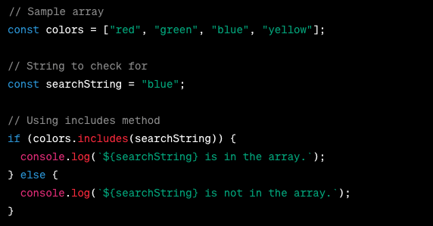
Interpreting JavaScript
JavaScript: A programming language used to add interactivity and dynamic behavior to web pages.
Browser interprets JavaScript code to handle user interactions, animations, and other dynamic features.
Examples: Form validation, image sliders, interactive games.

Slide 8
Role of JavaScript in Web Development
Enhanced User Experience:
JavaScript allows for dynamic content updates without reloading the entire webpage.
Interactive elements like forms, animations, and pop-ups enhance user engagement.
Client-Side Scripting:
JavaScript runs on the client side, meaning it's executed by the user's browser.
This reduces server load and improves website performance by offloading tasks to the client's machine.

Slide 9
Role of JavaScript in Web Development
DOM Manipulation:
The Document Object Model (DOM) represents the structure of a webpage.
JavaScript enables developers to manipulate DOM elements, altering their content, style, and behavior.
Asynchronous Programming:
JavaScript supports asynchronous operations, allowing tasks to execute independently without blocking other processes.
This is crucial for handling events, fetching data from servers, and ensuring smooth user interactions.

Slide 10
Role of JavaScript in Web Development
Cross-Browser Compatibility:
JavaScript code is supported by all major web browsers, including Chrome, Firefox, Safari, and Edge.
This ensures consistency in the behavior and appearance of web applications across different platforms.
Rich Ecosystem of Libraries and Frameworks:
JavaScript has a vast ecosystem of libraries (e.g., jQuery, React) and frameworks (e.g., Angular, Vue.js) that streamline development.
These tools provide pre-built components, modules, and utilities to expedite the creation of complex web applications.

Slide 11
Javascript Syntax and Data Types
There are two different types of data types in javascript:
Primitive data type
Primitive data types in JavaScript are like different kinds of puzzle pieces that computers use to understand and handle information, such as numbers, words, yes or no questions, empty spaces, and things that haven't been figured out yet.
Non-primitive data type
Non-primitive data types in JavaScript are like special helpers that make computers do tricky things, like sorting and following instructions step by step.

Slide 12
Variable And Its Scope
In JavaScript, var, let, and const are used to declare variables, but they have different behaviors and scoping rules.
var v = 10;
let a = 15;
const = 50;

Slide 13
Javascript Syntax and Data Types
Primitive Data Type
String
Boolean
Number
Undefined
Null
Non-Primitive Data Type
Object
Array
Function

Slide 14
Primitive Data Types
1. Numbers:
Numbers are like the digits you use for counting or doing math. They can be big or small, positive or negative, and even have decimal points. For example, if you want to know how many cookies you have, you'd use a number data type.
2. Strings:
Strings are like words or sentences. They're made up of letters, numbers, or symbols. So, if you want to write your name or a message to your friend, you'd use a string data type.
3. Booleans:
Booleans are like yes or no questions. They can only have two values: true or false. For instance, if you want to know if it's raining outside, you'd use a boolean data type. If it's raining, it's true; if it's not raining, it's false.
4. Null:
Null means nothing or empty. It's like having an empty box. There's nothing inside it. Sometimes, programmers use null when they want to say that something doesn't exist or has no value.
5. Undefined:
Undefined means something hasn't been defined or set yet. It's like having an empty space where something should be, but it hasn't been put there yet. It's used when we forget to give something a value or when it's not clear what the value should be.

Slide 15
Non Primitive Data Types
1. Objects:
Objects are like treasure chests that can hold many different types of things inside them. They can store numbers, words, and even other objects! For example, an object could represent your toy collection, with each toy having its own name and color.
2. Arrays:
Arrays are like special containers that can hold multiple items in a list. They're like shelves with lots of compartments where you can organize things. For instance, an array could store your favorite snacks in order, from first to last.
3. Functions:
Functions are like magic spells that perform specific tasks when called upon. They're like recipes that tell the computer what steps to follow. For example, a function could be a recipe for making your favorite sandwich, with instructions on how to put it together.

Slide 16
Javascript Variables
Number
let length = 10;
let width = 20;
String
let firstName = “ahmed”;
Let lastName = “ali”;
Boolean
let x = true;
Let y = false;
Object
const person = { “firsName” : “Ali”, “lastName” : “Hasan”} ;
Array Object
const colors = [ “Red”, “Blue”, “Green”, “Yellow” ];
Date Object
const date = new Date(“2024-03-21”);

Slide 17
Arithmatic Operators
Assignment Operator
Is used to assign values like let x = 10;
Addition/Subtraction Operator
Is used to add values like let x = 10; y = x + 40; z = x – 5;
Addition/Subtraction Assignment Operator
Is used to assign with addition into the same variable like let x = 10; x += 5; x -=3;

Slide 18
Math Operators
Addition (+): Adds two numbers together.
Example: 3 + 5 equals 8.
Subtraction (-): Subtracts one number from another.
Example: 7 - 4 equals 3.
Multiplication (*): Multiplies two numbers.
Example: 2 * 6 equals 12.
Division (/): Divides one number by another.
Example: 10 / 2 equals 5.
Modulus (%): Returns the remainder of a division operation.
Example: 10 % 3 equals 1, because 10 divided by 3 equals 3 with a remainder of 1.
Exponentiation ()**: Raises one number to the power of another.
Example: 2 ** 3 equals 8, because 2 raised to the power of 3 equals 8.

Slide 19
Escape character in String
Sometimes, we need to include special characters in strings, like quotes or newlines.
The Backslash ( \ ) Escape Character
It allows you to include special characters in a string.
Example:
let text = "He said, \"Hello World!\"";
let exampleString = "First line\nSecond line\tTabbed!";

Slide 20
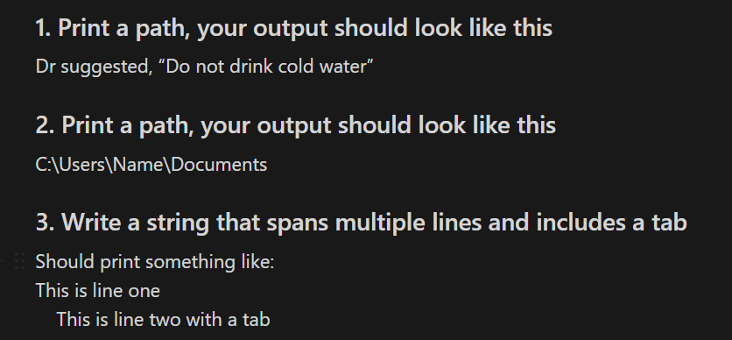
Escape character in String

Slide 21

Template Literals (back ticks)
We use backticks (`) to create a template literal:
Example
let greeting = `Hello, World!`;
Embedding Expressions

Slide 22
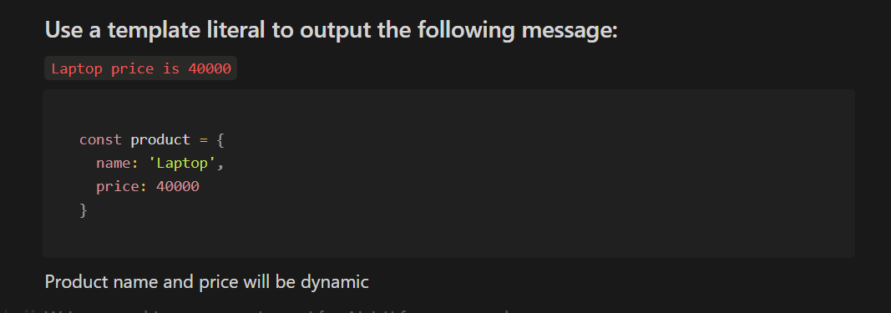
Template Literals Exercise

Slide 23
String Methods
Strings in JavaScript have built-in methods for performing various operations.
These methods make it easy to manipulate and analyze string data.
length Property:
The length property returns the number of characters in a string
toUpperCase() Method:
The toUpperCase() method converts a string to uppercase letters
toLowerCase() Method:
The toLowerCase() method converts a string to lowercase letters
indexOf() Method:
The indexOf() method returns the index of the first occurrence of a specified value in a string.
It returns -1 if the value is not found.

Slide 24
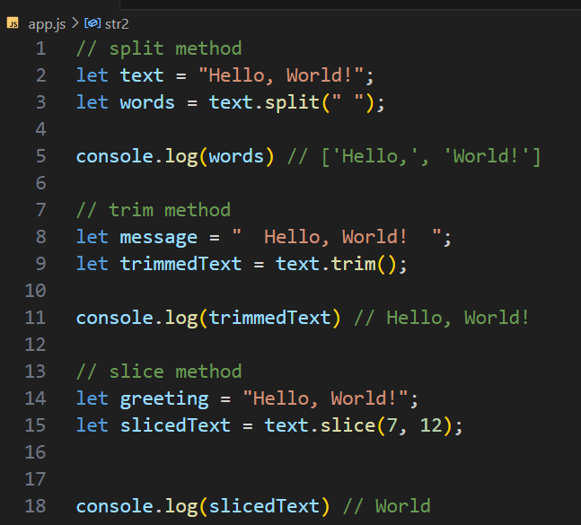
String Methods
split method: splits a string into an array of substrings based on a specified separator
slice method: extracts a part of a string and returns it as a new string
trim method: removes whitespace from both ends of a string

Slide 25
String Methods
Write a program to reverse a string
Input: we are learning Javascript
Output: tpircsavaJ gninrael era ew

Slide 26
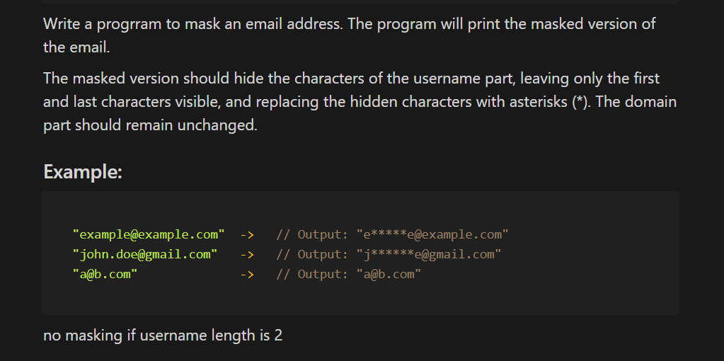
String Methods

Slide 27
Arrays
Collection: An array is like a box that can hold many items.
Order: Arrays allow us to organize related data by grouping them within a single variable.
Index: Each item in the array can be accessed using a number, called an index, that shows its position. The first item is at position 0, the second at position 1, and so on.

Slide 28
How to Create An Array
To create an array in JavaScript, we use square brackets [] and put the items inside, separated by commas.
Here’s an example:
let fruits = ['Apple', 'Banana', 'Cherry'];
fruits is the name of the array.
'Apple', 'Banana', and 'Cherry' are the items in the array.

Slide 29
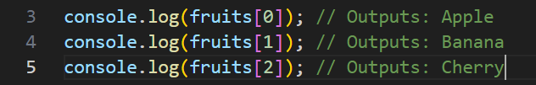
Access Array Elements
Javascript arrays are zero-indexed
You can get an item from the array by referring to its index (position). Remember, the first item is at index 0, the second item is at index 1, and so on.

Slide 30
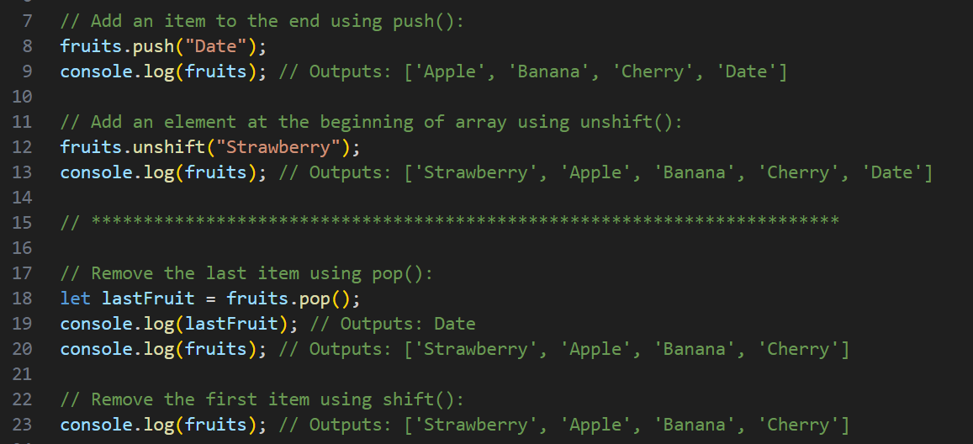
Add and Remove Array Element

Slide 31
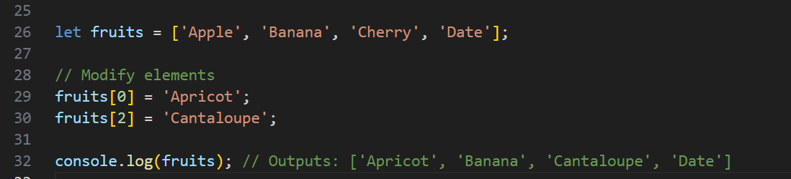
Change / Modify Array Element
We can add or change elements by accessing the index value.
For example,

Slide 32
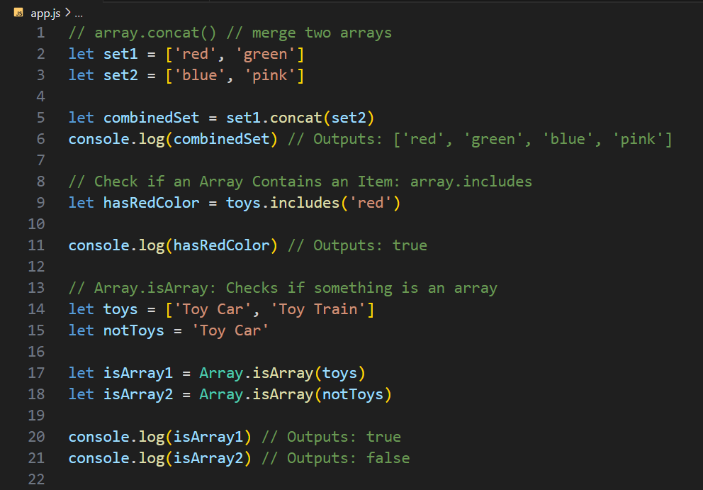
Common Array Methods
array.concat: Combines two or more arrays into one.
array.includes: Checks if an array contains a specific item.
Array.isArray: Checks if something is an array.

Slide 33
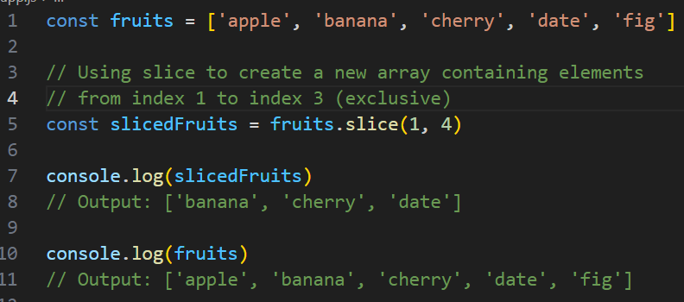
Slice vs Splice
slice() is a method that creates a new array containing elements from the original array. It doesn't modify the original array. We specify the starting and ending indexes, and it returns the elements within that range as a new array.
Use Cases:
When you need to extract a portion of an array without modifying the original array.
Useful for operations where you need to work with a subset of the original array.

Slide 34
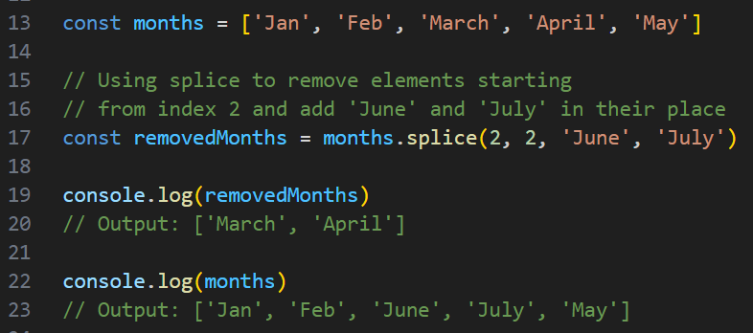
Slice vs Splice
splice() is a method that changes the contents of an array by removing or replacing existing elements and/or adding new elements.
It directly modifies the original array.
We specify the starting index, number of elements to remove, and optional new elements to add.
It returns an array containing the removed elements.
Use Cases:
When we need to remove elements from an array or replace them with new elements.
Useful for directly modifying the original array, such as when performing operations like adding, removing, or replacing elements.

Slide 35
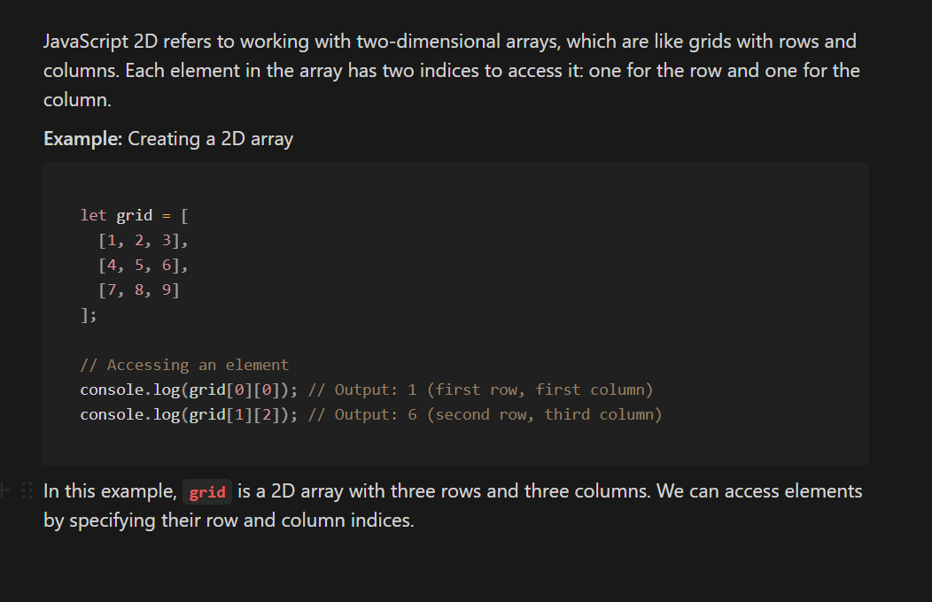
JavaScript 2D Array

Slide 36
JavaScript Objects
Objects are collections of properties
Properties are key-value pairs
To access data we use keys
Create New Object
Object Constructor
const obj = new Object({name: ‘Ali’})
Object initializer / Object literal syntax
const obj = {name: ‘Ali’}

Slide 37
Remember
All keys in object are converted to string except symbol
What if there are 2 keys with same name?

Slide 38
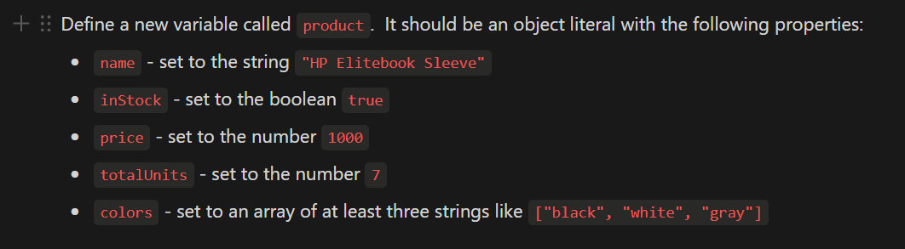
Object Exercise #1

Slide 39
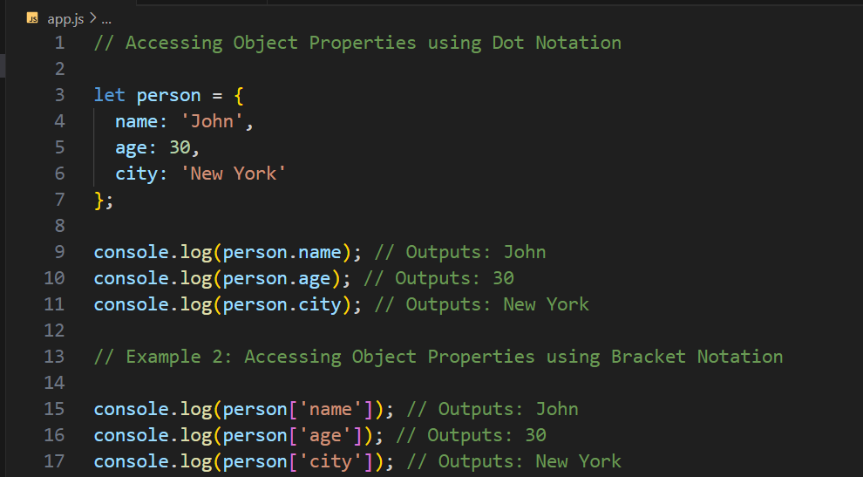
Way to access object properties
Using . Dot notation
Using [] square bracket
What’s the difference between?
How to access nested object?
How to access array inside object?
How to Accessing Object Properties Dynamically?

Slide 40
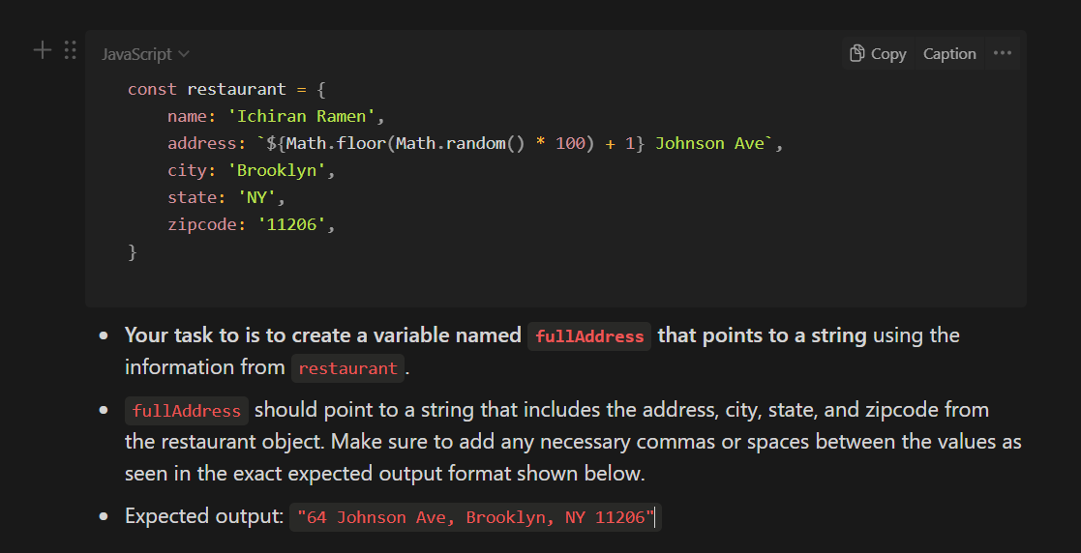
Object Exercise #2

Slide 41
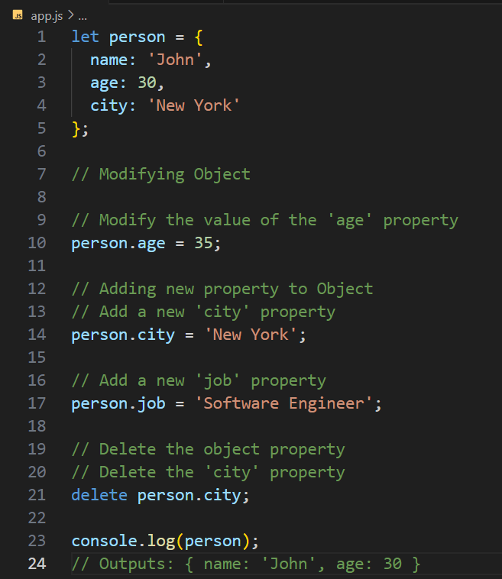
Modify, Add and Delete JS object properties

Slide 42
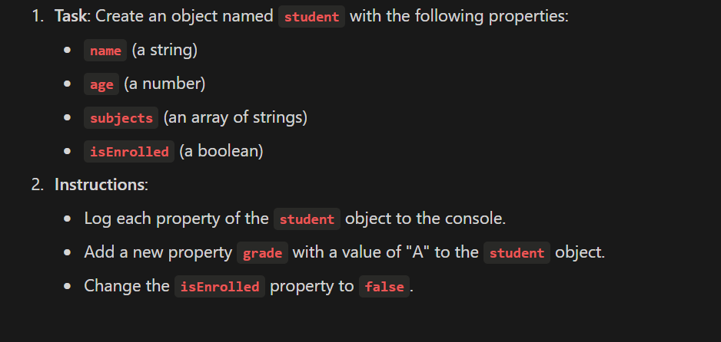
Object Exercise #3

Slide 43
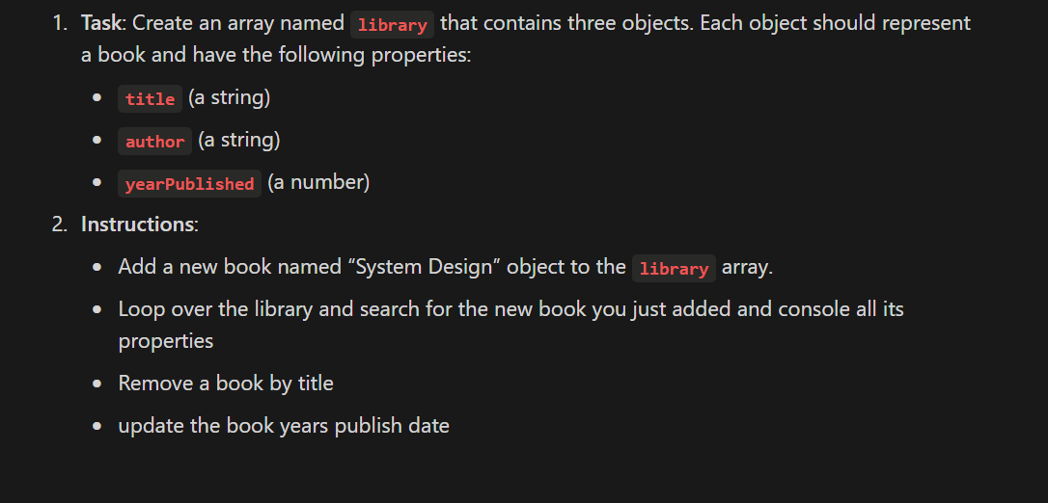
Array of Objects

Slide 44
The End

